Slide 1
CHAPTER five
Memory Management

Slide 2
Background
Program must be brought into memory and placed within a process for it to be executed.
Input queue or job queue – collection of processes on the disk that are waiting to be brought into memory for execution.
User programs go through several steps before being executed.

Slide 3
Memory management (MM)
It is the functionality of an operating system which manages primary memory and moves processes back and forth between main memory and disk during execution
Function of memory management
Keep track of every memory location
Keep track of whether memory is allocated or not
Keep track of how much memory is allocated
Takes decision which process will get memory and when
Updates the status of memory location. When it is allocated or freed.
Generally, there are 3 MM strategies: fetch strategies, placement strategies, and replacement strategy.

Slide 4
Memory management (MM)
Memory management resides in hardware, in the OS (operating system), and in programs and applications.
Fundamental task of the memory management is to ensure safe execution of program by providing :
Sharing memory
Memory protection

Slide 5
Issus in sharing memory
Transparency:- several process may co-exist, unaware of each other, in the main memory and run regardless of the number and location of processes.
Safety(protection):- processes must not corrupt each other( nor the OS).
Efficiency:- CPU utilization must be preserved and memory must be fairly allocated.
Relocation:- ability of program to run in different memory locations.

Slide 6
Memory address and description
Symbolic addresses: The addresses used in a source code. The variable names, constants, and instruction labels are the basic elements of the symbolic address space.
Relative addresses: At the time of compilation, a compiler converts symbolic addresses into relative addresses.
Physical addresses: The loader generates these addresses at the time when a program is loaded into main memory.

Slide 7
Memory management (MM)
Storage allocation
Information stored in main memory can be classified in a variety of ways.
Program (code) and data (variables, constants)
Read-only (code, constants) and read-write (variables)
Address (e.g., pointers) or data (other variables);

Slide 8
Memory management (MM)
The addresses in the source code are generally symbolic (like the variable count).
The compiler binds these addresses to relocatable addresses and these are bonded by the linker or loader to the absolute addresses.
Relocatable : Means that the program image can reside anywhere in physical memory
Binding : mapping from one address space to another (when memory is allocated for the object): static or dynamic
The compiler, linker, loader and run-time libraries all cooperate to manage this information

Slide 9
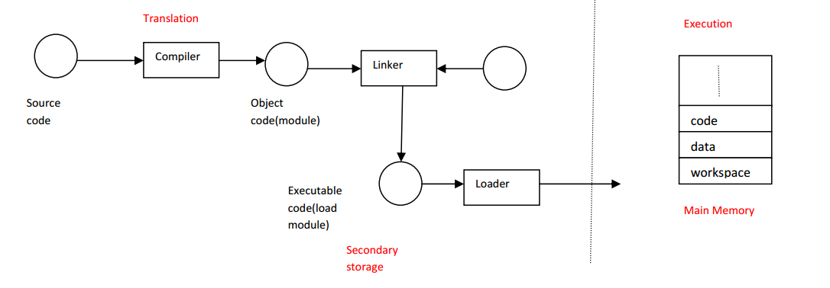
Creating an executable code
Before a program can be executed by the CPU, it must go through several steps:
Compiling (translating) : generates the object code.
Linking : combines the object code into a single self-sufficient executable code.
Loading : copies the executable code into memory.
Execution : dynamic memory allocation.

Slide 10
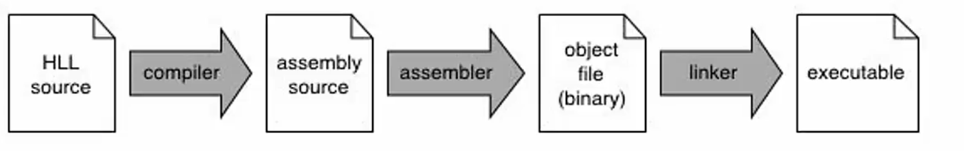
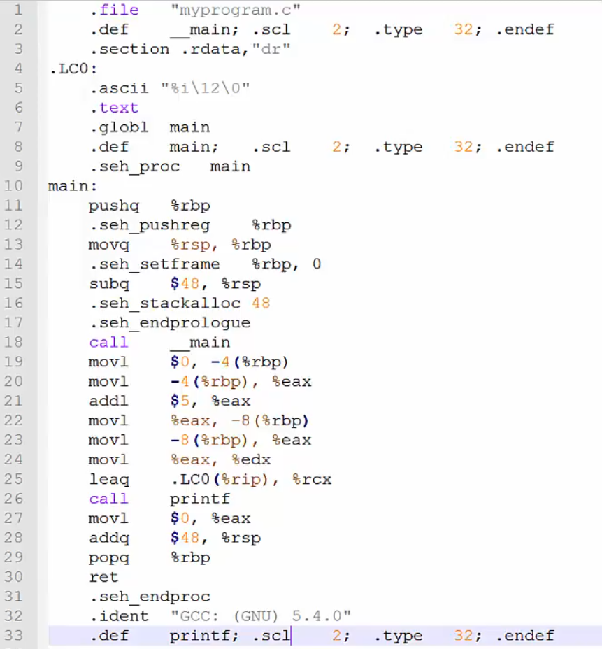
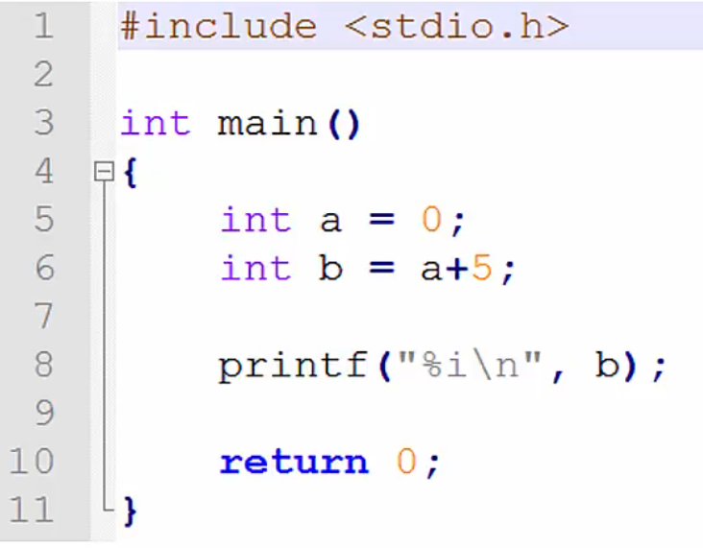
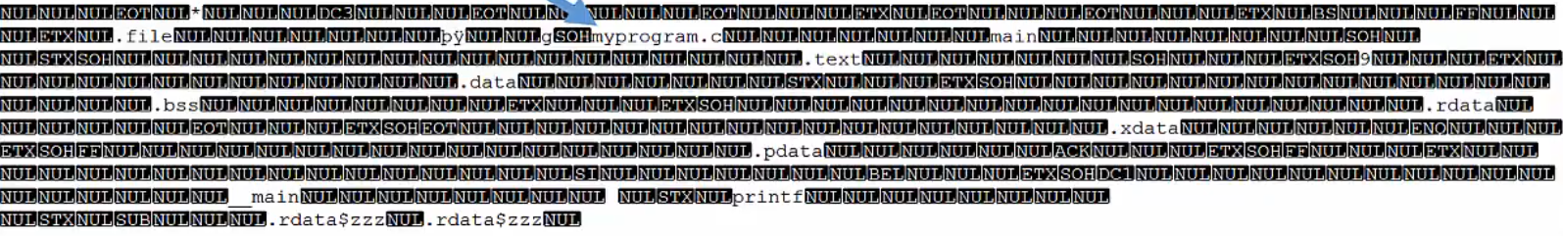
Creating an executable code
Q

Slide 11
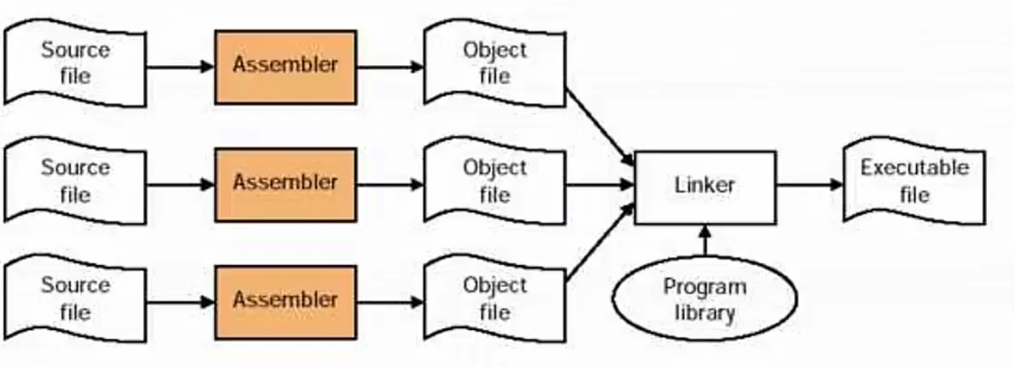
Creating an executable code
Q

Slide 12
Binding of Instructions and Data to Memory
Address binding of instructions and data to memory addresses can happen at three different stages.
Compile time: If we initially know where the process is residing in the memory at the time of compilation, then absolute code can be generated. If the starting location changes, then the code has to be recompiled.
Load time: If the memory address where the process resides is not known at the compile time, then the compiler must generate relocatable code if memory location is not known at compile time.
Execution time: Binding delayed until run time if the process can be moved during its execution from one memory segment to another. Need hardware support for address maps (e.g., base and limit registers).

Slide 13
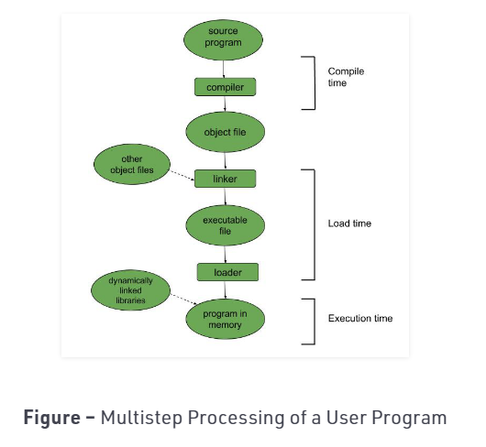
Binding of Instructions and Data to Memory
Binding can be done at compile/link time.
Converts symbolic to relocatable.
Data used within compiled source is offset within object module.
Can be done at load time.
Binds relocatable to physical.
Can be done at run time. Implies that the code can be moved around during execution.

Slide 14
Static or Dynamic Loading
The choice between Static or Dynamic Loading is to be made at the time of computer program being developed.
Static loading
If you have to load your program statically, then at the time of compilation, the complete programs will be compiled and linked without leaving any external program or module dependency.
The linker combines the object program with other necessary object modules into an absolute program, which also includes logical addresses.
Dynamic loading
If you are writing a Dynamically loaded program, then your compiler will compile the program and for all the modules which you want to include dynamically, only references will be provided and rest of the work will be done at the time of execution.

Slide 15
Static or Dynamic Loading
Routine is not loaded until it is called
Better memory-space utilization; unused routine is never loaded.
Useful when large amounts of code are needed to handle infrequently occurring cases.
No special support from the operating system is required implemented through program design.
Generally
At the time of loading, with static loading, the absolute program (and data) is loaded into memory in order for execution to start.
If you are using dynamic loading, dynamic routines of the library are stored on a disk in relocatable form and are loaded into memory only when they are needed by the program.

Slide 16
Static Vs dynamic linking
Static linking
when static linking is used, the linker combines all other modules needed by a program into a single executable program to avoid any runtime dependency.
Dynamic linking
When dynamic linking is used, it is not required to link the actual module or library with the program, rather a reference to the dynamic module is provided at the time of compilation and linking.
Linking postponed until execution time.
Dynamic Link Libraries (DLL) in Windows and Shared Objects in Unix are good examples of dynamic libraries.
Small piece of code, stub, used to locate the appropriate memory-resident library routine.
Stub replaces itself with the address of the routine, and executes the routine.

Slide 17
Static Vs dynamic linking
Dynamic linking
A stub is a small program routine that substitutes for a longer program, possibly to be loaded later
It is a piece of code that converts parameters passed between client and server during a remote procedure call (RPC).
Operating system needed to check if routine is in processes’ memory address.

Slide 18
Overlays
The concept of overlays is that whenever a process is running it will not use the complete program at the same time, it will use only some part of it.
Then overlays concept says that whatever part you required, you load it an once the part is done, then you just unload it, means just pull it back and get the new part you required and run it.
Keep in memory only those instructions and data that are needed at any given time.
Needed when process is larger than amount of memory allocated to it.
Implemented by user, no special support needed from operating system, programming design of overlay structure is complex.
Advantage
Reduce memory requirement
Reduce time requirement

Slide 19
Logical vs. Physical Address Space
The concept of a logical address space that is bound to a separate physical address space is central to proper memory management.
Logical address – generated by the CPU; also referred to as virtual address.
Physical address – address seen by the memory unit.
Logical and physical addresses are the same in compile-time and load-time address-binding schemes; logical (virtual) and physical addresses differ in execution-time address-binding scheme.

Slide 20
Memory-Management Unit (MMU)
Hardware device that maps virtual to physical address.
In MMU scheme, the value in the relocation register is added to every address generated by a user process at the time it is sent to memory.
The user program deals with logical addresses; it never sees the real physical addresses.

Slide 21
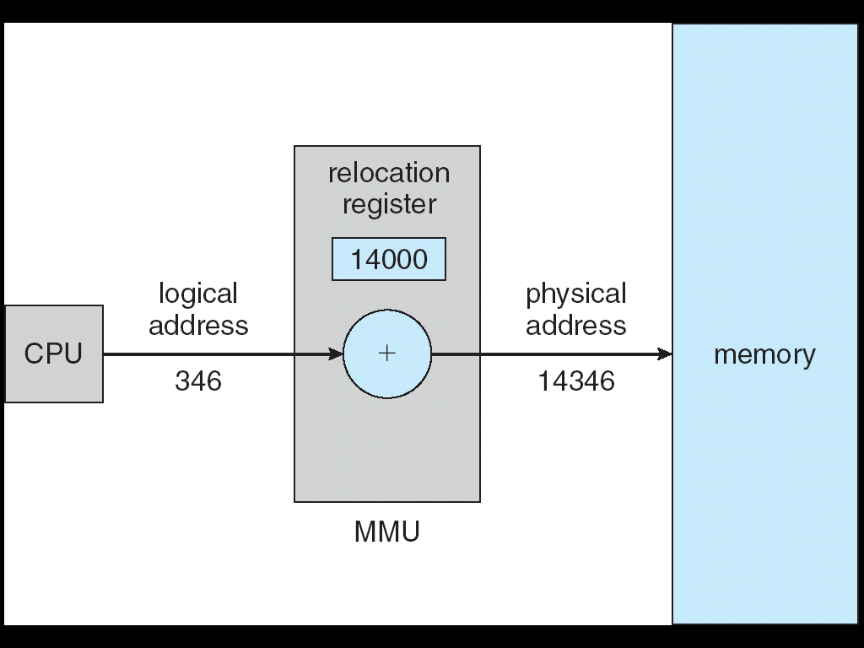
Dynamic relocation using a relocation register
D

Slide 22
Memory Allocation
Memory allocation is the process of reserving a partial or complete portion of computer memory for the execution of programs and processes. Memory allocation is achieved through a process known as memory management.
Memory is a large array of bytes, where each byte has its own address. The memory allocation can be classified into two methods contiguous memory allocation and non-contiguous memory allocation.
The major difference between Contiguous and Noncontiguous memory allocation is that:
The contiguous memory allocation assigns the consecutive blocks of memory to a process requesting for memory.
whereas, the noncontiguous memory allocation assigns the separate memory blocks at the different location in memory space in a nonconsecutive manner to a process requesting for memory.

Slide 23
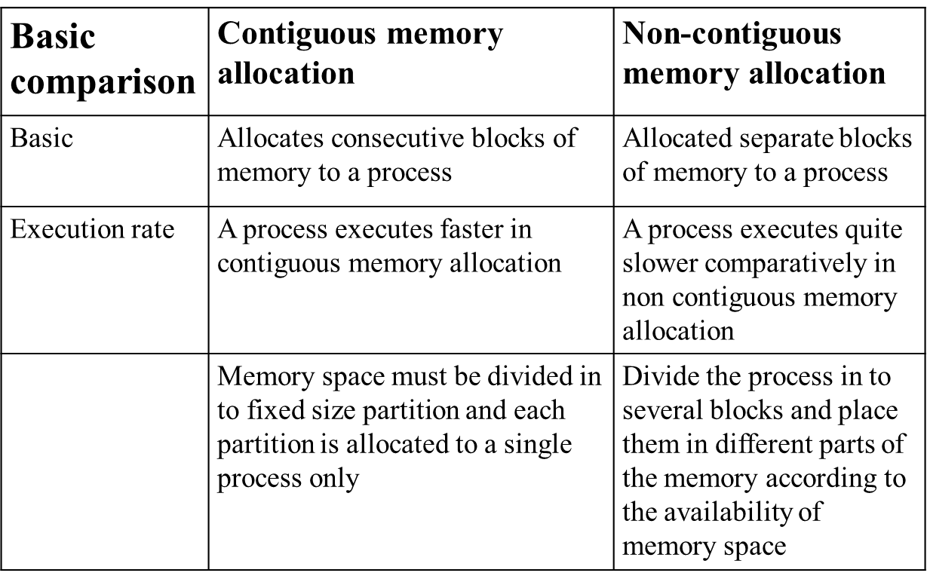
Contiguous and non contiguous memory allocation

Slide 24
Contiguous memory allocation
It is further subdivided into Fixed-partition storage allocation strategy and variable partition storage allocation strategy.
Fixed-partition contiguous storage allocation:-
processes with small address space use small partitions and processes with large address space use large partitions.
This is known as fixed partition contiguous storage allocation.
Three strategies that can be used to allocate memory to fixed – partition
They are the following:
First - fit
Best – Fit
Worst – fit

Slide 25
Fixed size partition ….
First fit
A resource allocation scheme (usually for memory).
First Fit fits data into memory by scanning from the beginning of available memory to the end, until the first free space which is at least big enough to accept the data is found.
This space is then allocated to the data. Any left over becomes a smaller, separate free space.
If the data to be allocated is bigger than the biggest free space, the request cannot be met, and an error is generated.

Slide 26
Fixed size partition ….
Best fit
The best fit deals with allocating the smallest free partition which meets the requirement of the requesting process.
This algorithm first searches the entire list of free partitions and considers the smallest hole that is adequate. It then tries to find a hole which is close to actual process size needed.
Worst fit
The algorithm searches for free-space in memory in which it can store the desired information.
The algorithm selects the largest possible free space that the information can be stored on (i.e. that is bigger than the information needing to be stored) and stores it there.
This is directly opposed to the best fit algorithm which searches the memory in much the same way as before.

Slide 27
Variable size- partition
This notion is derived from parking of vehicles on the sides of streets where the one who manages to enter will get the space.
Two vehicles can leave a space between them that cannot be used by any vehicle.
This means that whenever a process needs memory, a search for the space needed by it, is done.
If contiguous space is available to accommodate that process, then the process is loaded into memory.

Slide 28
External fragmentation
After execution of process when they are swapped out of memory and other smaller processes replace them, many small non contiguous blocks of unused spaces are formed which can serve a new request if all of them are put together but as they are not adjacent to each other a new request can not be served.
This phenomenon of entering and leaving the memory can cause the formation of unusable memory holes (like the unused space between two vehicles). This is known as External Fragmentation.

Slide 29
Non-contiguous Storage Allocation
To resolve the problem of external fragmentation and to enhance the degree of multiprogramming to a greater extent, it was decided to sacrifice the simplicity of allocating contiguous memory to every process.
It was decided to have a non-contiguous physical address space of a process so that a process could be allocated memory wherever it was available.
There are 2 techniques for non-contiguous allocation:
Segmentation
Paging

Slide 30
Paging
Paging is a memory management technique in which process address space is broken into blocks of the same size called pages
Divide physical memory into fixed-sized blocks called frames (size is power of 2, between 512 bytes and 8192 bytes).
The size of the process is measured in the number of pages.
Keep track of all free frames.
To run a program of size n pages, need to find n free frames and load program.
Set up a page table to translate logical to physical addresses.
Internal fragmentation.

Slide 31
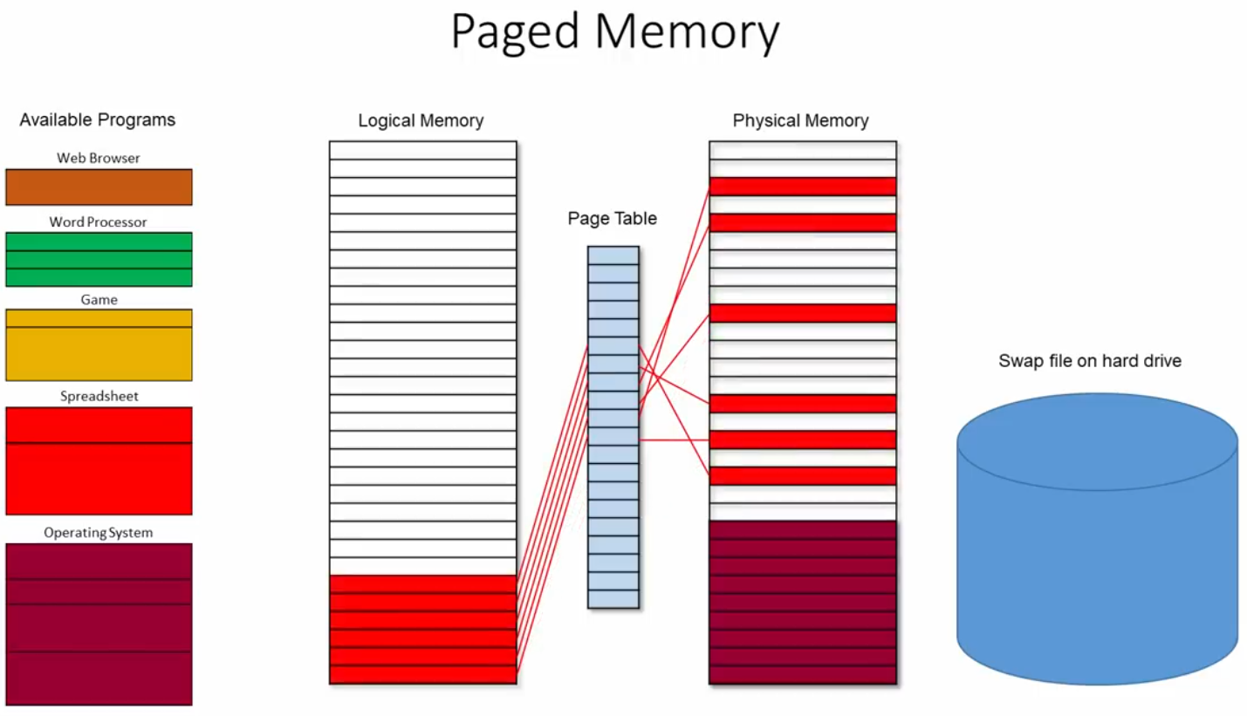
Paging
D

Slide 32
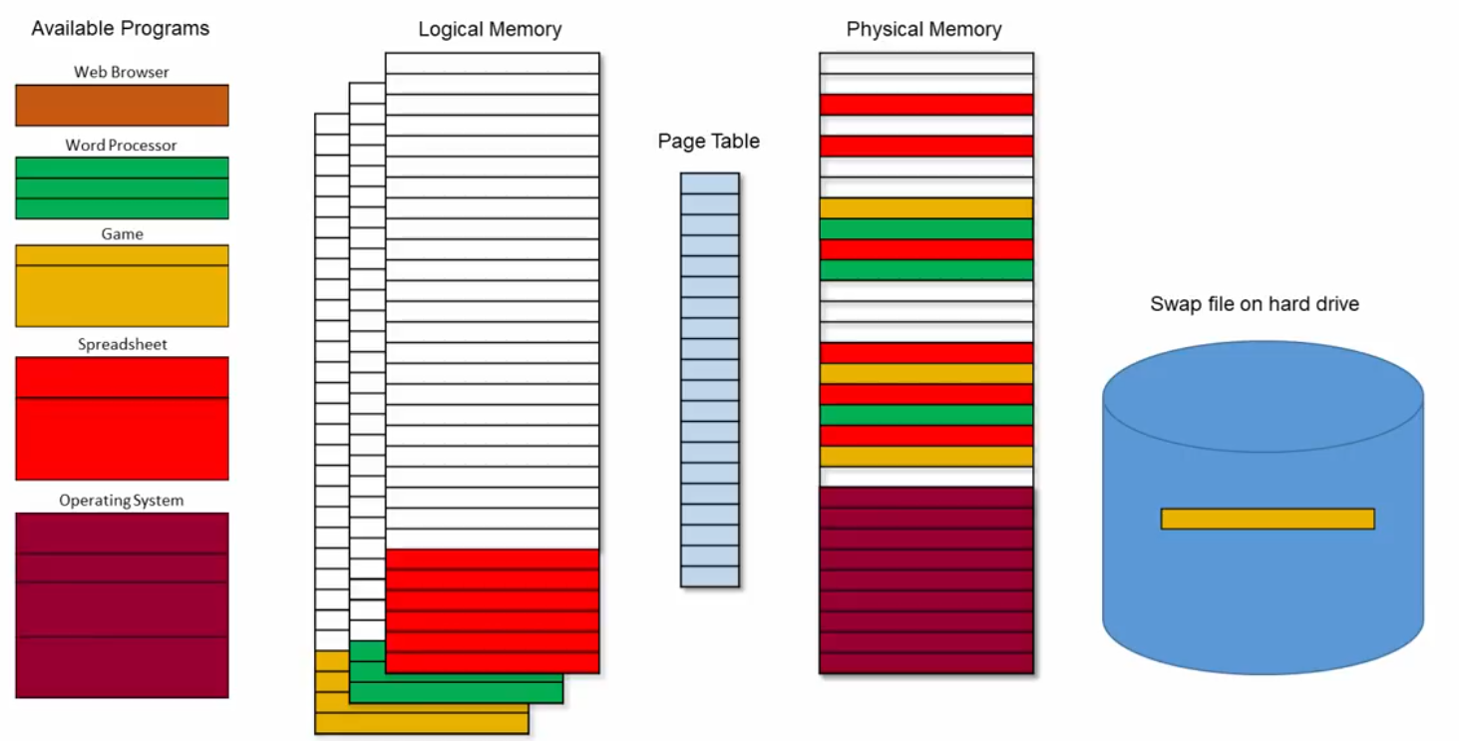
Paging
D

Slide 33
Address Translation Scheme
Page address is called logical address and represented by page number and the offset.
Page number (p) – used as an index into a page table which contains base address of each page in physical memory
Page offset (d) – combined with base address to define the physical memory address that is sent to the memory unit
For given logical address space 2^{m} and page size 2^{n}
page number
page offset
P | d
m - n
n

Slide 34
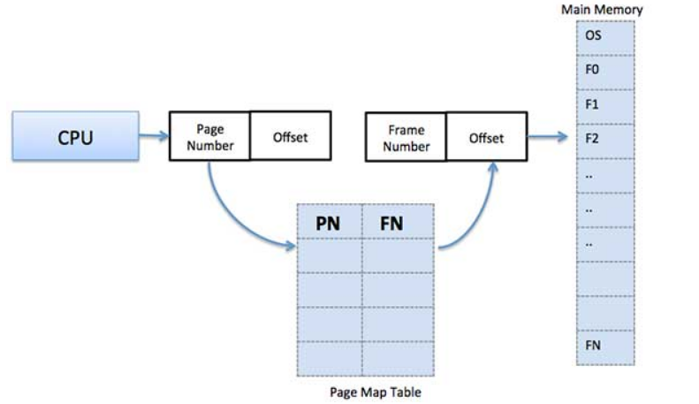
Address Translation Scheme
Frame address is called physical address and represented by a frame number and the offset.
Physical Address = Frame number + page offset
The following diagram shows address translation architecture.

Slide 35
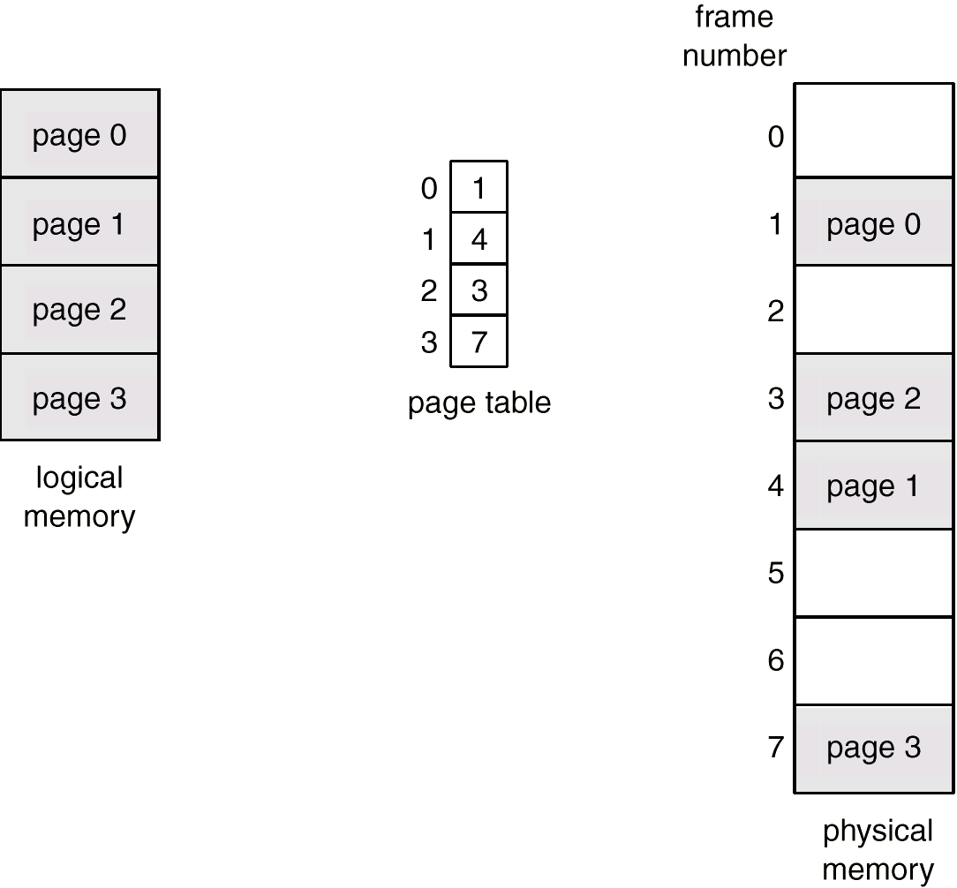
Paging Example
D

Slide 36
Implementation of Page Table
Page table is kept in main memory.
Page-table base register (PTBR) points to the page table.
Page-table length register (PRLR) indicates size of the page table.
In this scheme every data/instruction access requires two memory accesses. One for the page table and one for the data/instruction.
The two memory access problem can be solved by the use of a special fast-lookup hardware cache called associative registers or translation look-aside buffers (TLBs)

Slide 37
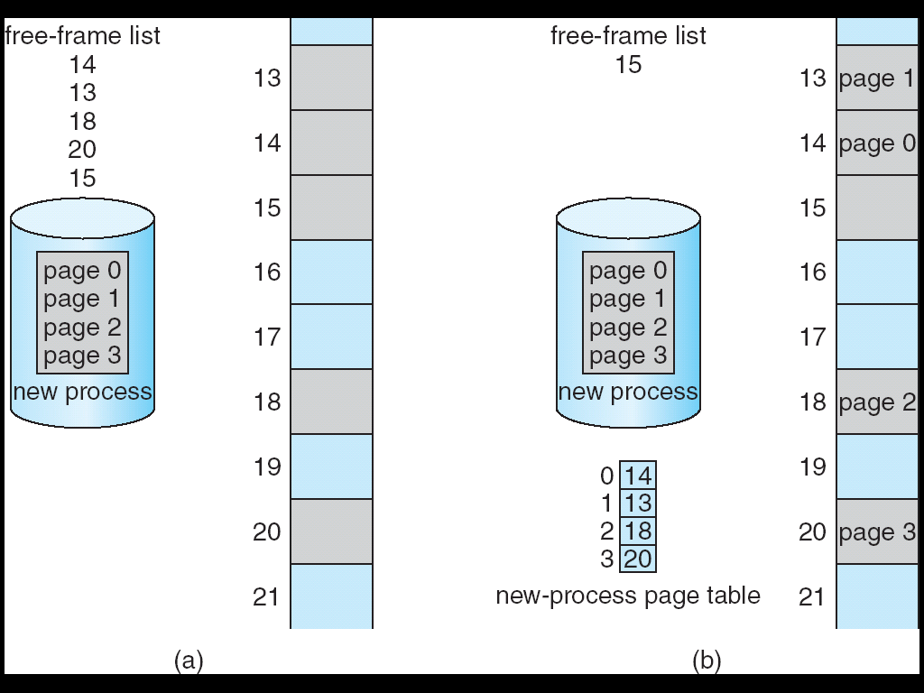
Free Frames
D

Slide 38
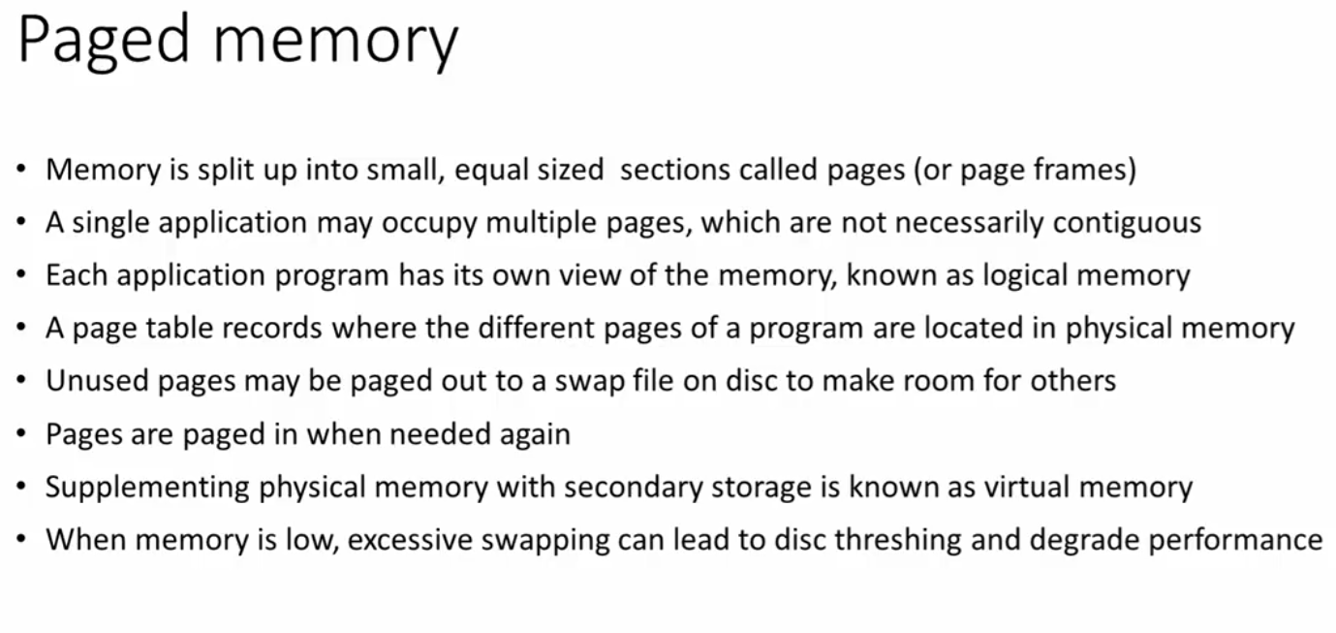
Summary
D

Slide 39
Memory Protection
Memory protection implemented by associating protection bit with each frame.
Valid-invalid bit attached to each entry in the page table:
“valid” indicates that the associated page is in the process’ logical address space, and is thus a legal page.
“invalid” indicates that the page is not in the process’ logical address space.

Slide 40
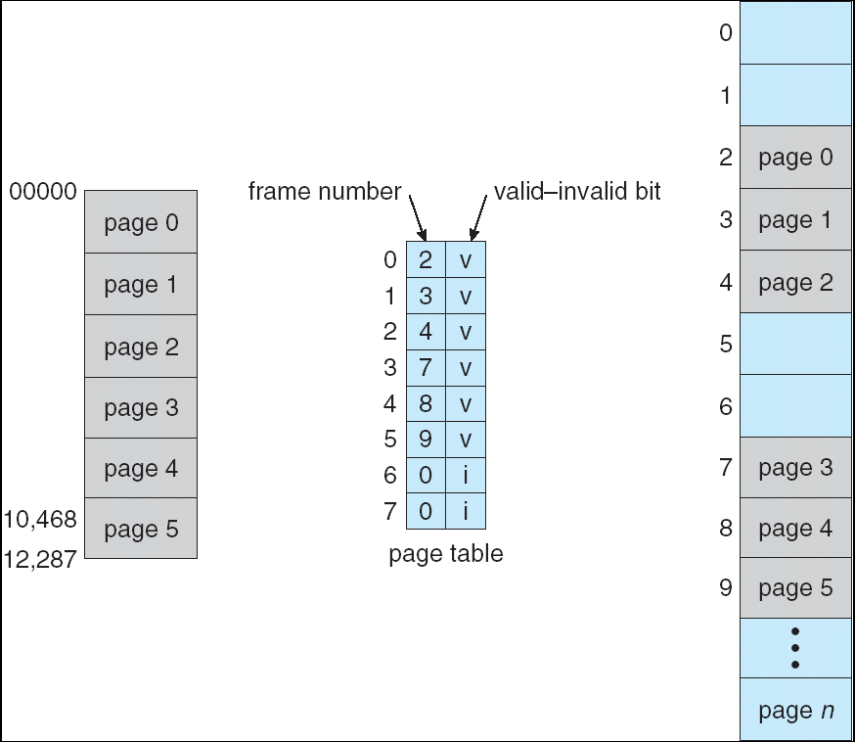
Valid (v) or Invalid (i) Bit In A Page Table
D

Slide 41
Shared Pages
Shared code
One copy of read-only (reentrant) code shared among processes (i.e., text editors, compilers, window systems).
Shared code must appear in same location in the logical address space of all processes
Private code and data
Each process keeps a separate copy of the code and data
The pages for the private code and data can appear anywhere in the logical address space

Slide 42
Segmentation
Each job is divide into several segments of different sizes, one for each module that contains pieces that perform related functions.
Each segment is actually a different logical address space of the program.
Memory-management scheme that supports user view of memory
A program is a collection of segments. A segment is a logical unit such as:
main program,
procedure,
function,
method,
object,
local variables, global variables,
common block,
stack,
symbol table, arrays

Slide 43
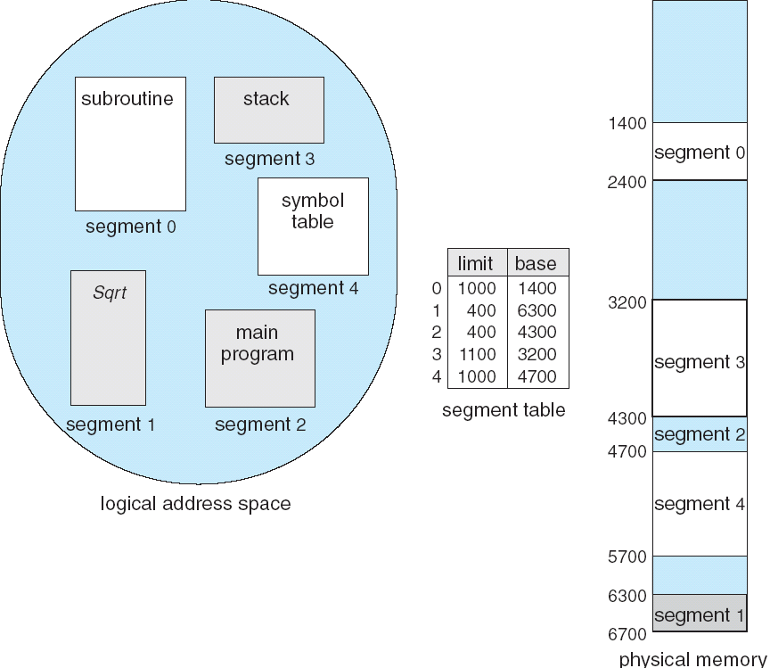
Example of Segmentation
D

Slide 44
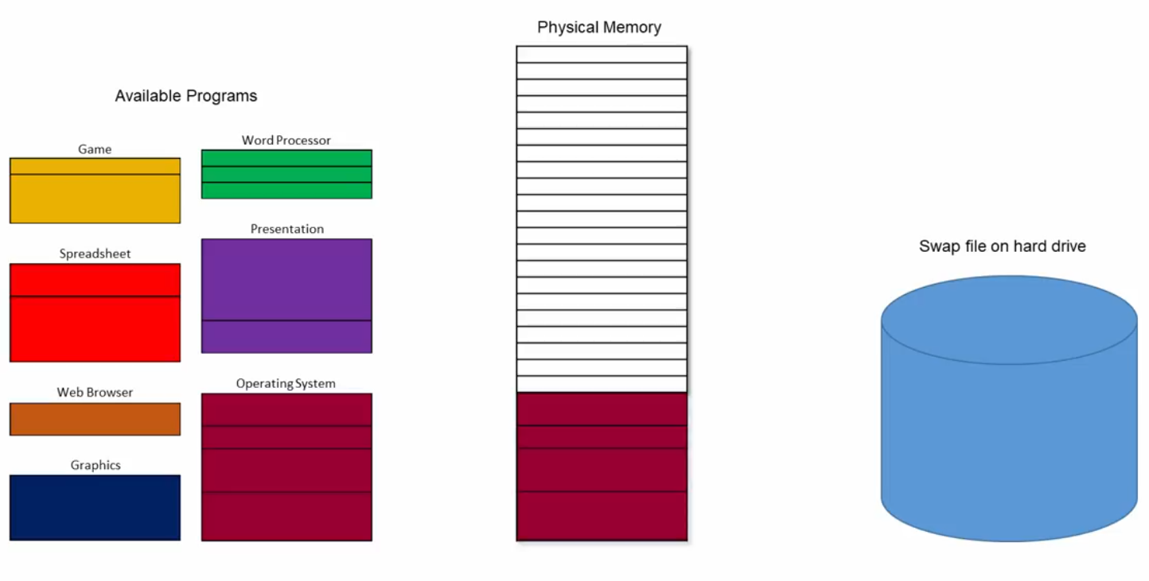
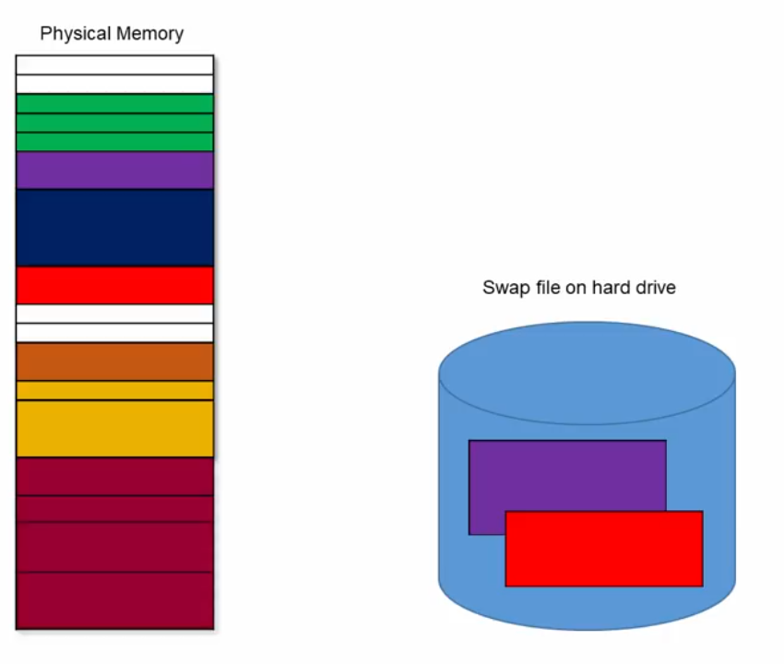
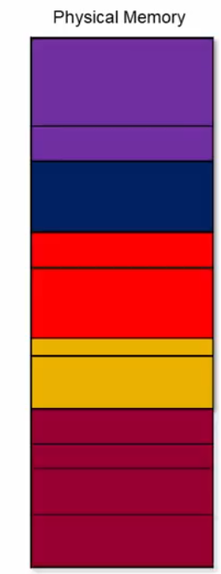
Example of Segmentation
D

Slide 45
Segmentation Architecture
Logical address consists of a two tuple:
<segment-number, offset>,
Segment table – maps two-dimensional physical addresses; each table entry has:
base – contains the starting physical address where the segments reside in memory
limit – specifies the length of the segment
Segment-table base register (STBR) points to the segment table’s location in memory
Segment-table length register (STLR) indicates number of segments used by a program;
segment number s is legal if s < STLR

Slide 46
Segmentation Architecture
Protection
With each entry in segment table associate:
validation bit = 0 ⇒ illegal segment
read/write/execute privileges
Protection bits associated with segments; code sharing occurs at segment level
Since segments vary in length, memory allocation is a dynamic storage-allocation problem
A segmentation example is shown in the following diagram.

Slide 47
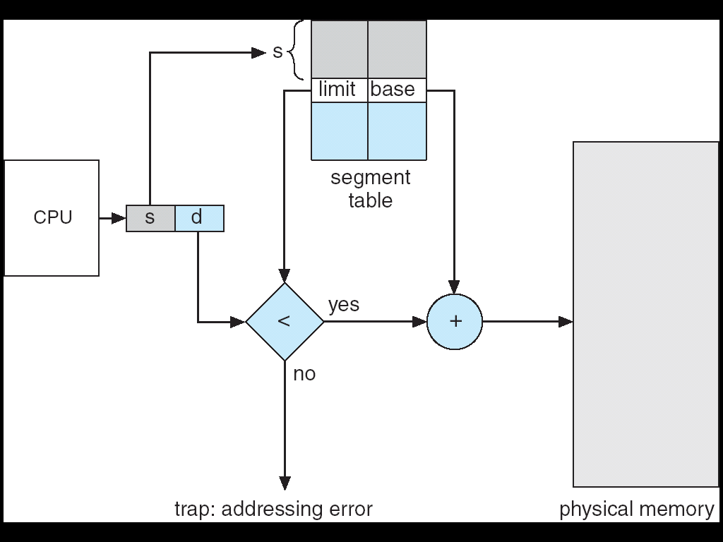
Segmentation Hardware
D

Slide 48
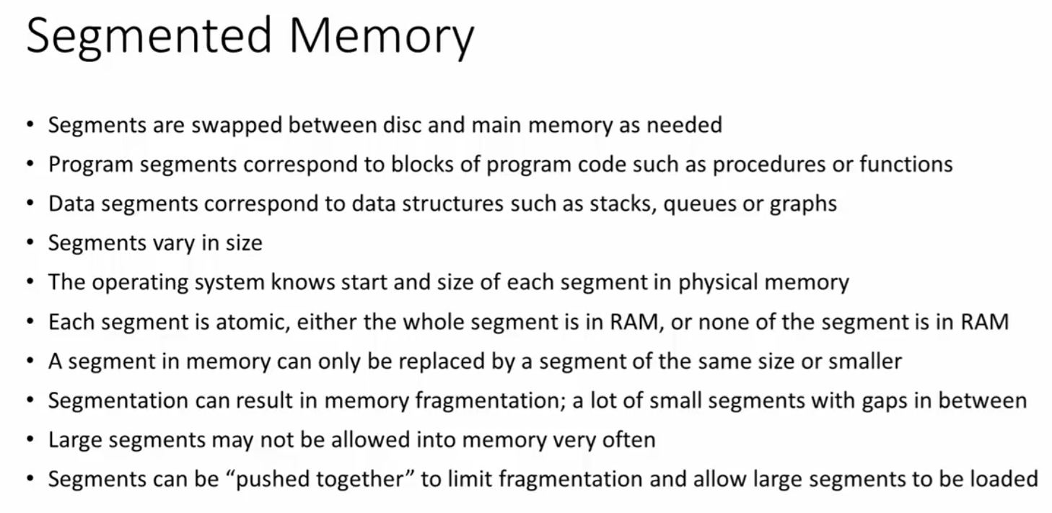
Summary of segmented memory
D

Slide 49
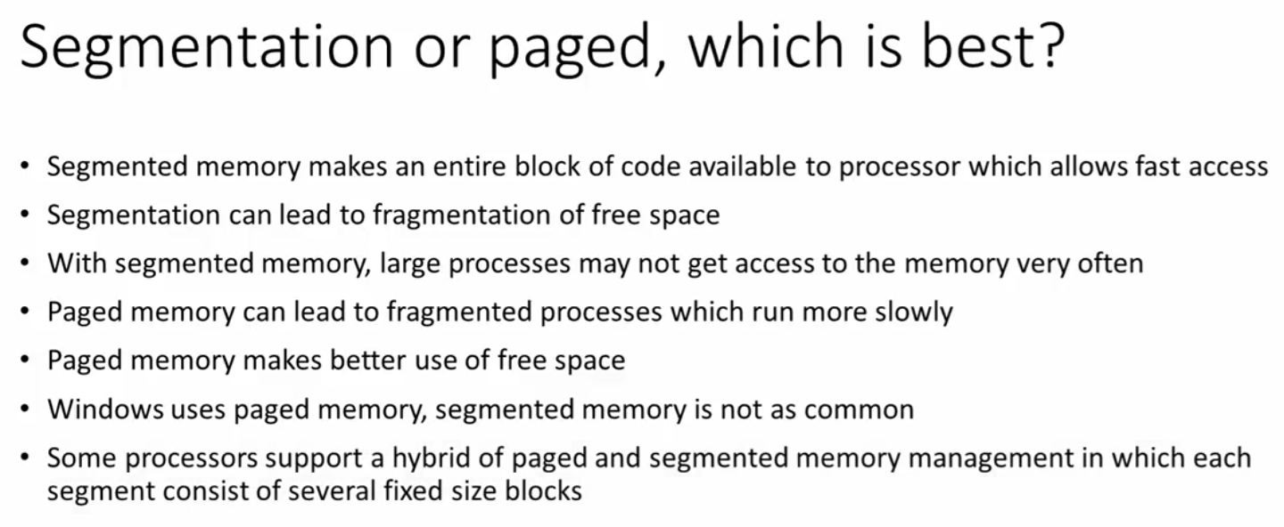
Segmentation or paged, which is best?
D

Slide 50
Swapping
A process can be swapped temporarily out of memory to a backing store (secondary storge device), and then brought back into memory for continued execution.
Roll out, roll in – swapping variant used for priority-based scheduling algorithms; lower-priority process is swapped out so higher-priority process can be loaded and executed.
The total time taken by swapping process includes the time it takes to move the entire process to a secondary disk and then to copy the process back to memory, as well as the time the process takes to regain main memory.

Slide 51
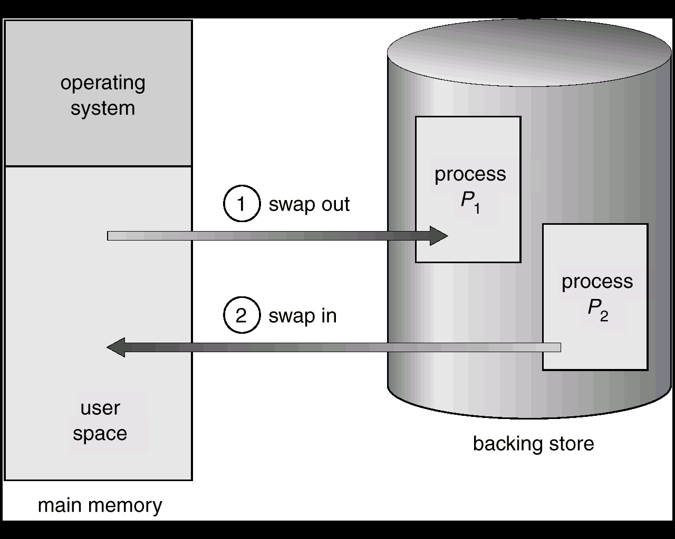
Schematic View of Swapping
D

Slide 52
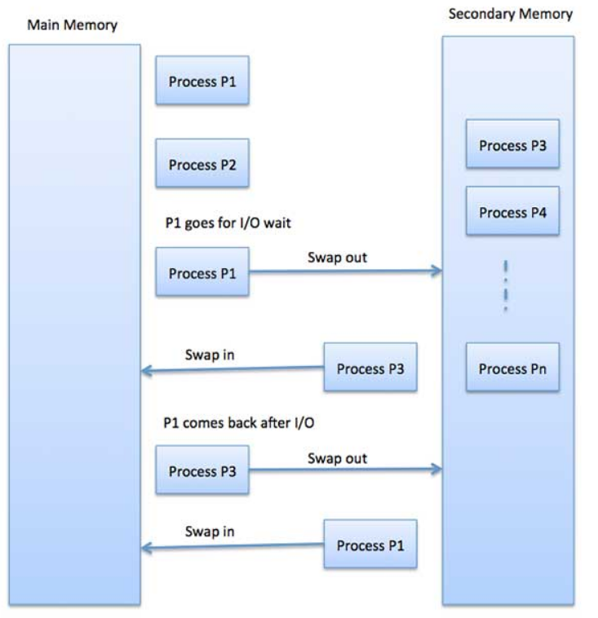
Schematic View of Swapping
D

Slide 53
Virtual memory
Virtual memory – separation of user logical memory from physical memory.
Only part of the program needs to be in memory for execution.
Logical address space can therefore be much larger than physical address space.
Need to allow pages to be swapped in and out.
Virtual memory can be implemented via:
Demand paging
Demand segmentation

Slide 54
Demand Paging
Bring a page into memory only when it is needed.
Less I/O needed
Less memory needed
Faster response
More users
Page is needed ⇒ reference to it
invalid reference ⇒ abort
not-in-memory ⇒ bring to memory

Slide 55
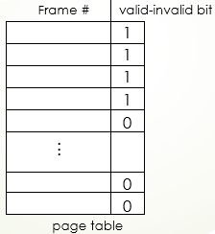
Valid-Invalid Bit
With each page table entry a valid–invalid bit is associated (1 ⇒ in-memory, 0 ⇒ not-in-memory)
Initially valid–invalid but is set to 0 on all entries.
Example of a page table snapshot.
During address translation, if valid–invalid bit in page table entry is 0 ⇒ page fault.

Slide 56
Page Fault
If there is ever a reference to a page, first reference will trap to OS ⇒ page fault
OS looks at another table to decide:
Invalid reference ⇒ abort.
Just not in memory.
Get empty frame.
Swap page into frame.
Reset tables, validation bit = 1.
Restart instruction: Least Recently Used
block move
auto increment/decrement location

Slide 57
What happens if there is no free frame?
Page replacement – find some page in memory, but not really in use, swap it out.
Algorithm
performance – want an algorithm which will result in minimum number of page faults.
Same page may be brought into memory several times.

Slide 58
Page Replacement
Prevent over-allocation of memory by modifying page-fault service routine to include page replacement.
Use modify (dirty) bit to reduce overhead of page transfers – only modified pages are written to disk.
Page replacement completes separation between logical memory and physical memory – large virtual memory can be provided on a smaller physical memory.

Slide 59
Page-Replacement Algorithms
Want lowest page-fault rate.
Evaluate algorithm by running it on a particular string of memory references (reference string) and computing the number of page faults on that string.
In all our examples, the reference string is
1, 2, 3, 4, 1, 2, 5, 1, 2, 3, 4, 5.

Slide 60
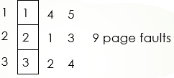
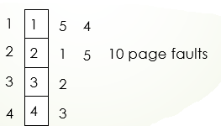
First-In-First-Out (FIFO) Algorithm
Reference string: 1, 2, 3, 4, 1, 2, 5, 1, 2, 3, 4, 5
3 frames (3 pages can be in memory at a time per process)
4 frames
FIFO Replacement – Belady’s Anomaly
more frames ⇒ less page faults

Slide 61
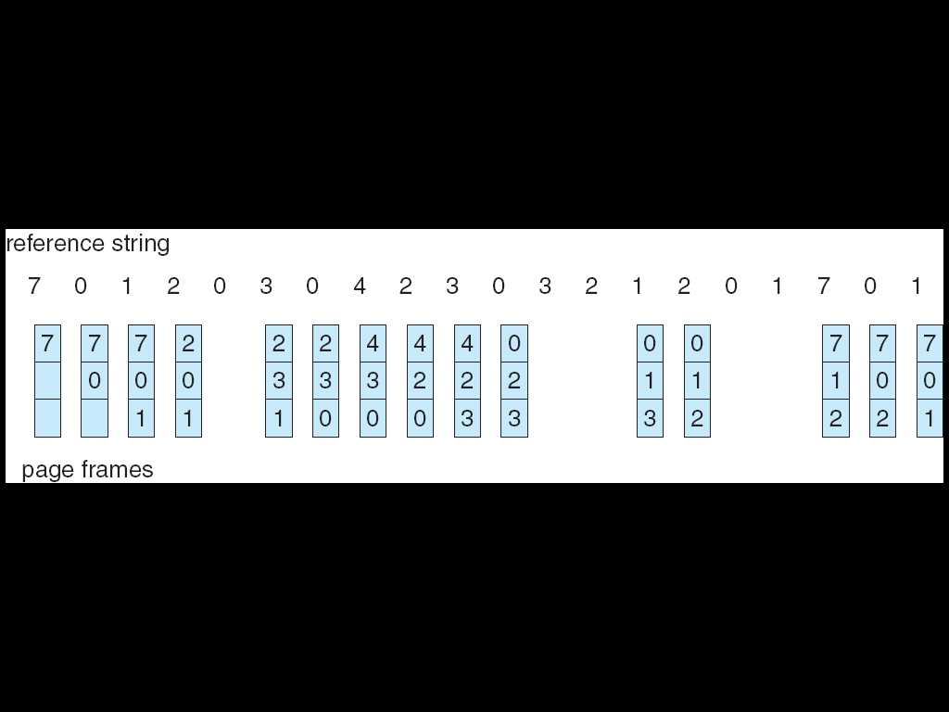
FIFO Page Replacement

Slide 62
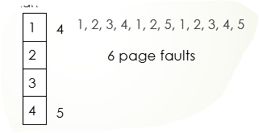
Optimal Algorithm
Replace page that will not be used for longest period of time.
4 frames example
How do you know this?
Used for measuring how well your algorithm performs.

Slide 63
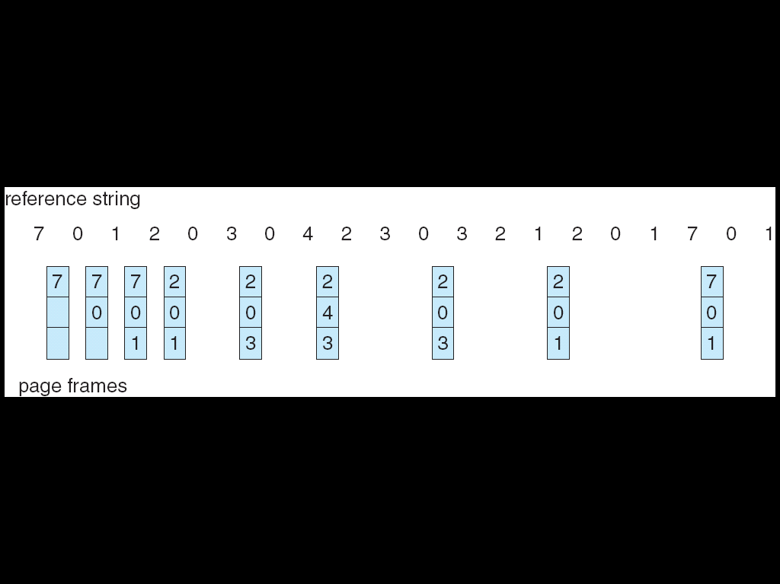
Optimal Page Replacement

Slide 64
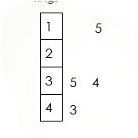
Least Recently Used (LRU) Algorithm
Reference string: 1, 2, 3, 4, 1, 2, 5, 1, 2, 3, 4, 5
Counter implementation
Every page entry has a counter; every time page is referenced through this entry, copy the clock into the counter.
When a page needs to be changed, look at the counters to determine which are to change.

Slide 65
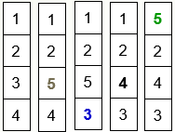
Least Recently Used (LRU) Algorithm
Reference string: 1, 2, 3, 4, 1, 2, 5, 1, 2, 3, 4, 5
Counter implementation
Every page entry has a counter; every time page is referenced through this entry, copy the clock into the counter
When a page needs to be changed, look at the counters to determine which are to change

Slide 66
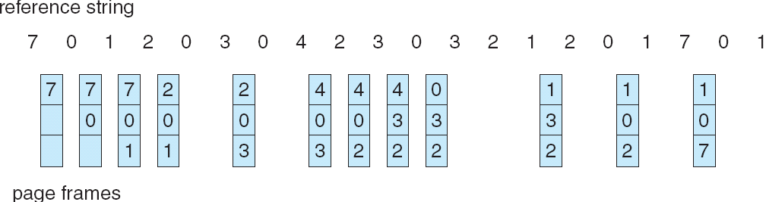
LRU Page Replacement

Slide 67
LRU Page Replacement
Stack implementation – keep a stack of page numbers in a double link form:
Page referenced:
move it to the top
requires 6 pointers to be changed
No search for replacement

Slide 68
Thrashing
If a process does not have “enough” pages, the page-fault rate is very high. This leads to:
low CPU utilization
operating system thinks that it needs to increase the degree of multiprogramming
another process added to the system
Thrashing ≡ a process is busy swapping pages in and out

Slide 69
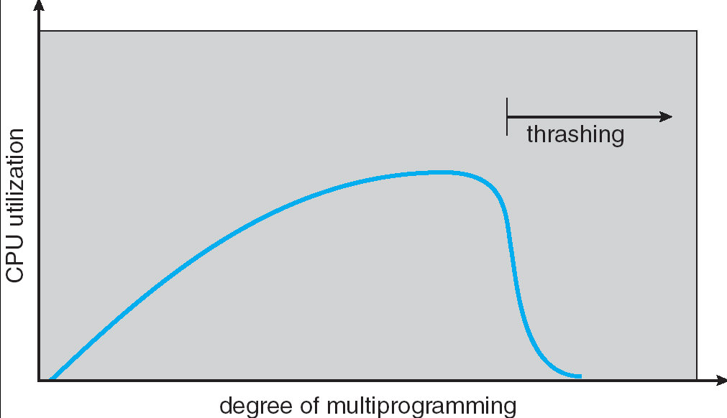
Thrashing

